Slide 1
Low-Rent Buildings and Crime Locations in New York City
Nicholas Kinberg
December 10, 2019

Slide 2
Problem
New York City has, since the mid-1990s, assuaged its crime problem. However, increasing gentrification in Manhattan and the other boroughs of the city has pushed poverty to the geographic and social margins, making crime a problem for just the poor instead of the rich and poor.
How can New York City address the problems of poverty and crime such that those of lesser means can live comfortable lives without the scourge of predation?
Crime is defined as acts from a robbery to a homicide. Crime locations do not include the locations at which people committed low-level crimes like smoking marijuana.

Slide 3
Audience
The audience of this project will be the New York City government, as well as the residents of Harlem, the Bronx, far upper and lower Manhattan, eastern Queens, and western Brooklyn.

Slide 4
Data Used
I used crime, building, and parcel data from NYC.gov Spatial Data, the USA Geocoding Service, and Columbia GIS Data. I put these data on a map with WGS84(DD). I downloaded a map of New York City from Washington University’s GISData drive.
To supplement my policy analysis, I included peace research from my course “International Conflict Management and Resolution.” More specifically, I related my analysis to How Wars End and research from the Center for Strategic and International Studies (CSIS).

Slide 5
Methods
I stored relative pathways while working on my maps. I collected data by scouring NYC.gov Spatial Data and Columbia GIS Data. To find the parcel and building data, I also found this through NYC.gov. NYC.gov is a better source at which to find crime statistics for the entire city, while Columbia GIS Data is optimal for finding crime statistics for Manhattan. To find a map of New York City, I searched on Washington University’s GISData drive. To put all data on the same plane, I used the WGS84(DD) coordinate system for both maps. I used CSV files and shapefiles, as well as a geodatabase I downloaded from NYC.gov, to visualize the data.
To find low-rent buildings near crime locations, I first selected parcels and buildings 0.1 miles or closer to crime locations. I then created a new layer for these two items and assumed that buildings with lower elevation correlated with lower rent. I made this assumption because lower buildings are much more common in low-rent cities than high-rises. I then deleted all buildings with an elevation above 50 feet for both maps. After this, I emphasized areas with high crime incidents.

Slide 6
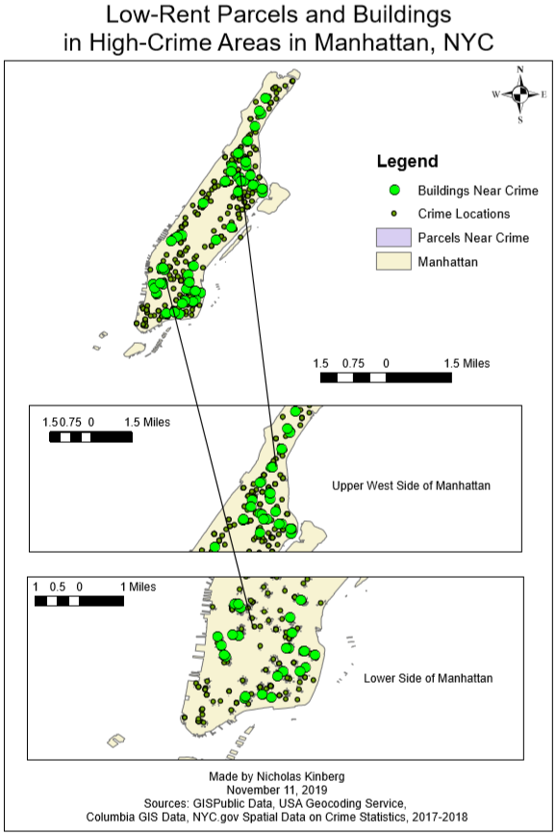
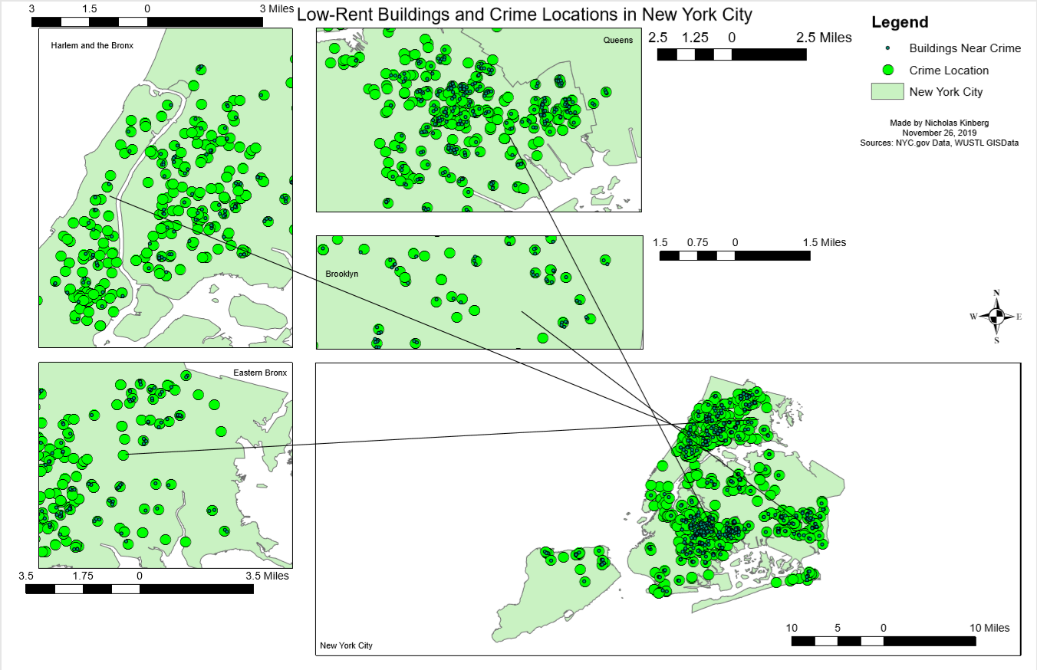

Slide 7
Policy Recommendations
As with peace research, crime and the propensity of people to profit from predation decrease as the prevalence of third-party actors increases. People are unable to prey on each other if law enforcement provides an effective deterrent to initiating crime (Reiter, 2009). New York City’s government should increase police presence in far upper and lower Manhattan, in Harlem and the Bronx, in eastern Queens, and in western Brooklyn. Furthermore, these police units should form substantive relationships with their respective communities to root out crime.
From there, crime will dissipate and communities will strengthen, thus producing higher income (Cusack, 2013). These better lives will lead to the dissipation of poverty and increase the standard of living for the aforementioned locations in New York City.

Slide 8
Next Steps
Check on increased police presence program one year after initiation
Compare crime levels in 2020 to those in 2018
If crime levels are lower, continue program and work with communities to address economic grievances
Produce a report on economic grievances in far upper and lower Manhattan, Harlem and the Bronx, eastern Queens and western Brooklyn by 2022
Implement policy recommendations from report to improve living standards in these locations

Slide 9
Challenges Encountered
I still have difficulty mapping data onto maps. This is because I haven’t practiced doing this enough.
Data on buildings and parcels didn’t include information on how much each parcel or building costed, unlike the information with which we worked to create maps on St. Louis City and County.

Slide 10
Works Cited
Cusack, Jake, and Matt Tilleard. “Investment Facilitation in Transitional and Fragile States.”
Investment Facilitation in Transitional and Fragile States. Center for Strategic and International Studies, December 2013. https://csis-prod.s3.amazonaws.com/s3fs-public/legacy_files/files/publication/131213_Cusack_InvestmentFacilitation_Web.pdf.
Reiter, Dan. How Wars End. Princeton: Princeton University Press, 2009.

